Slide 1

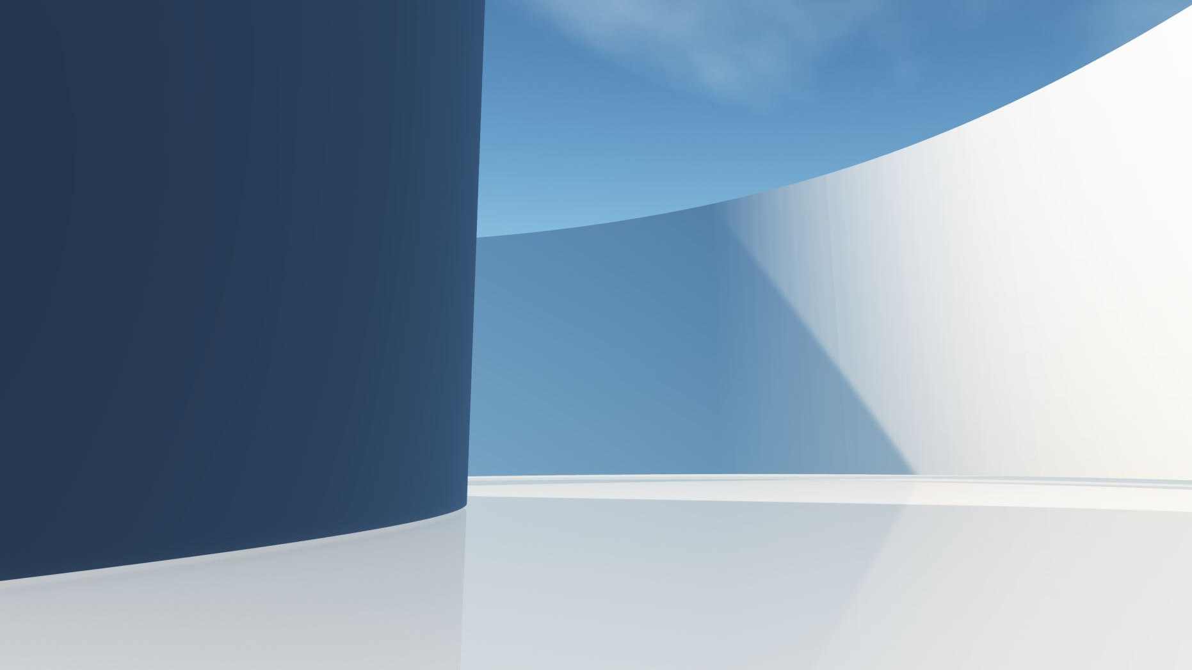
Blockchain Technology Depiction using Fictional Currency Transaction
Made by:
Ashnuta Upadhyaya
Registration number; 219301432
Section: c

Slide 2

Outline/Idea
Blockchain can be referred to as a secure immutable ledger, wherein all transactions or recordings happening can be safely stored eliminating the middleman situation and making it quick and reliable.
This project basically is a representation of how blockchain actually works, further using the technology to show a fictional transaction wherein data is being stored resulting to the generation of a unique hash.
Any minute changes in the data consequently changes the hash of each of the block drastically which is what the main use of blockchain technology is.

Slide 3
Introduction
Blockchain, in simple terms is reliable decentralized Database, which is immutable an distributed in Peer-to-Peer Network.
Anything if changed or corrupted in a blockchain results to notifying everyone who is required to get an alert. Which makes it highly transparent, safe and secure.
Blockchain was first invented in the 90s however the real application was unveiled in 2009 by Satashi Nakamoto who used blockchain and created a cryptocurrency called Bitcoin.

Slide 4
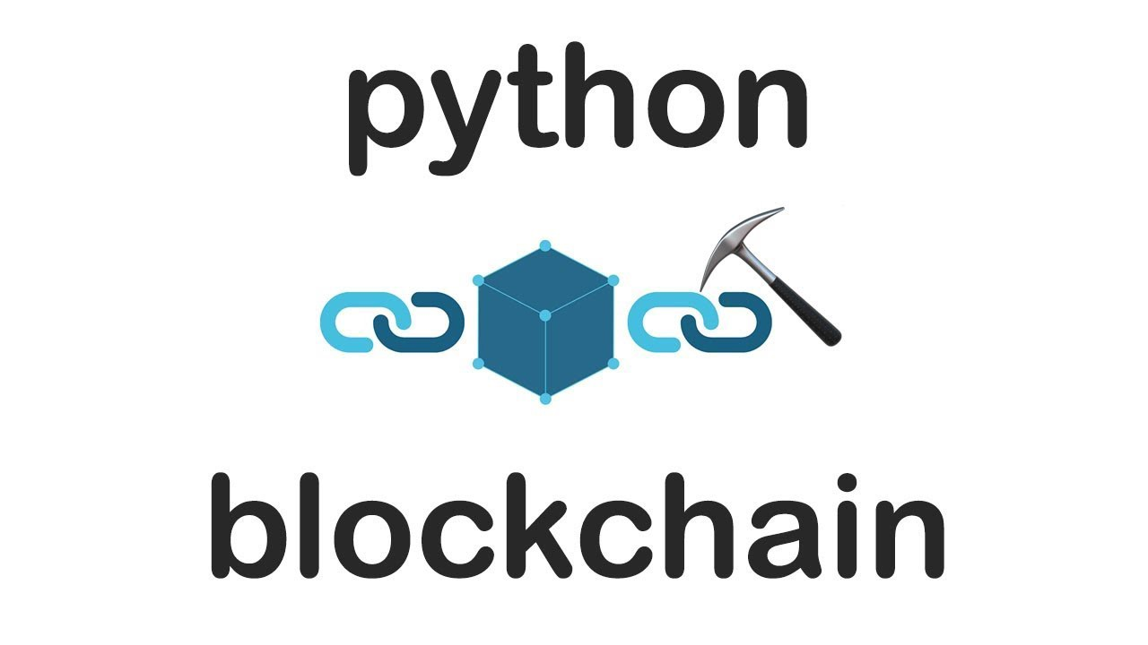
Technology Used
In my project I have solely used Python and created a fictional currency transaction whose hash is being generated and displayed to primarily show how blockchain works.

Slide 5

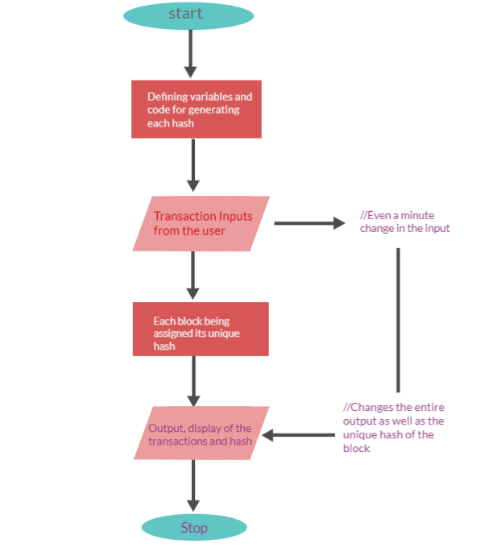


Flow Diagram

Slide 6
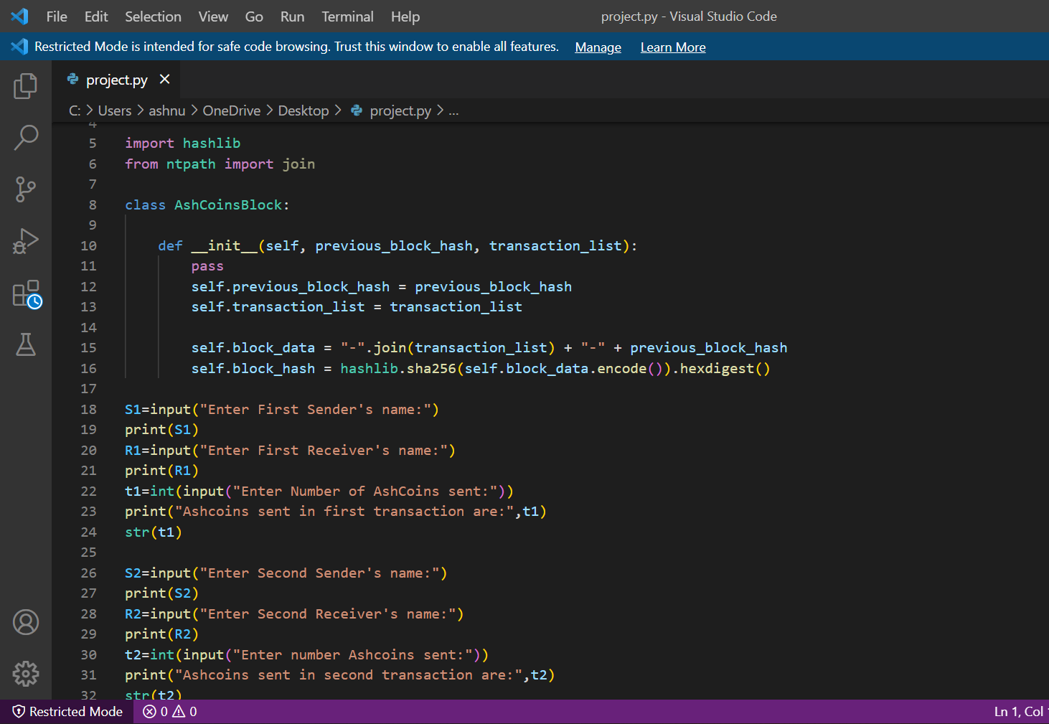
Source Code

Slide 7
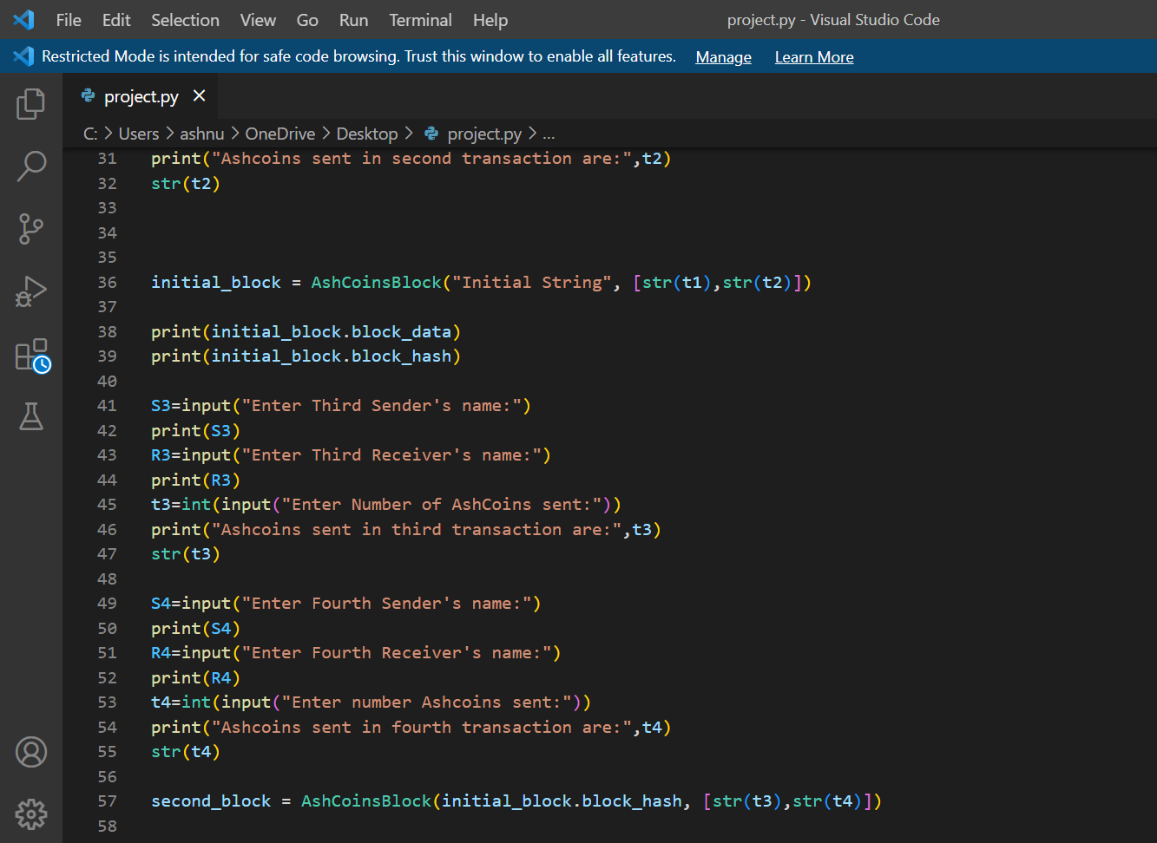

Slide 8
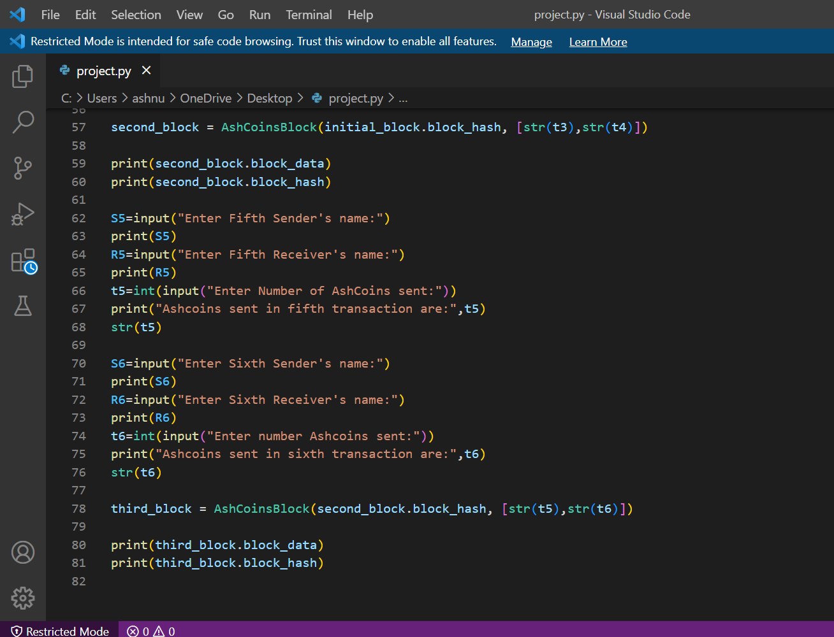

Slide 9
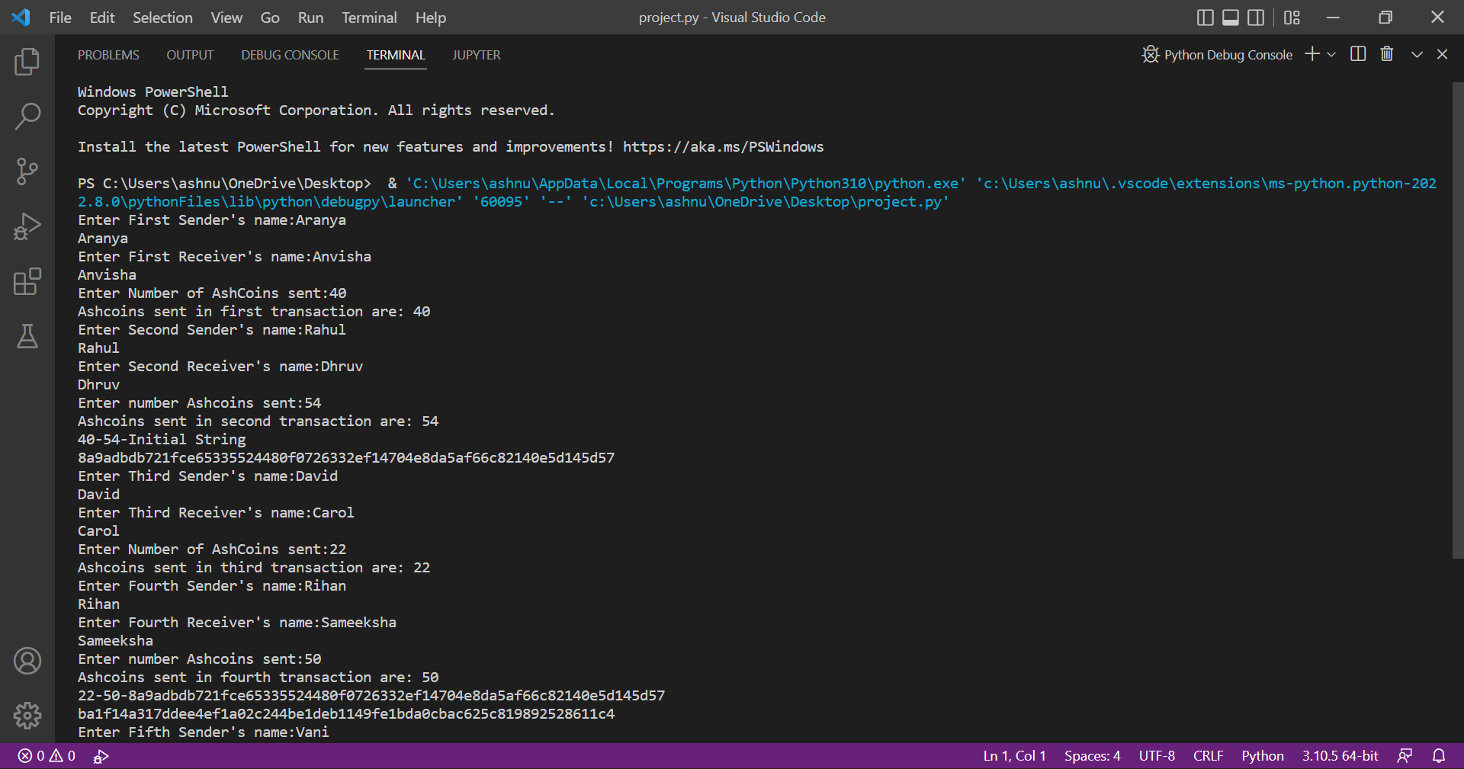
Output

Slide 10
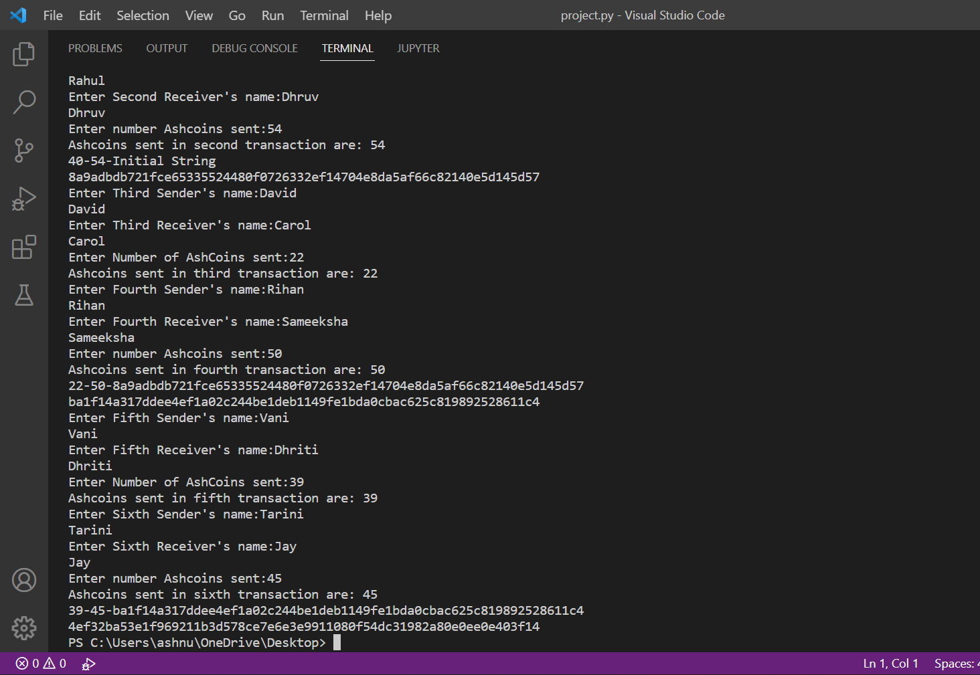

Slide 11
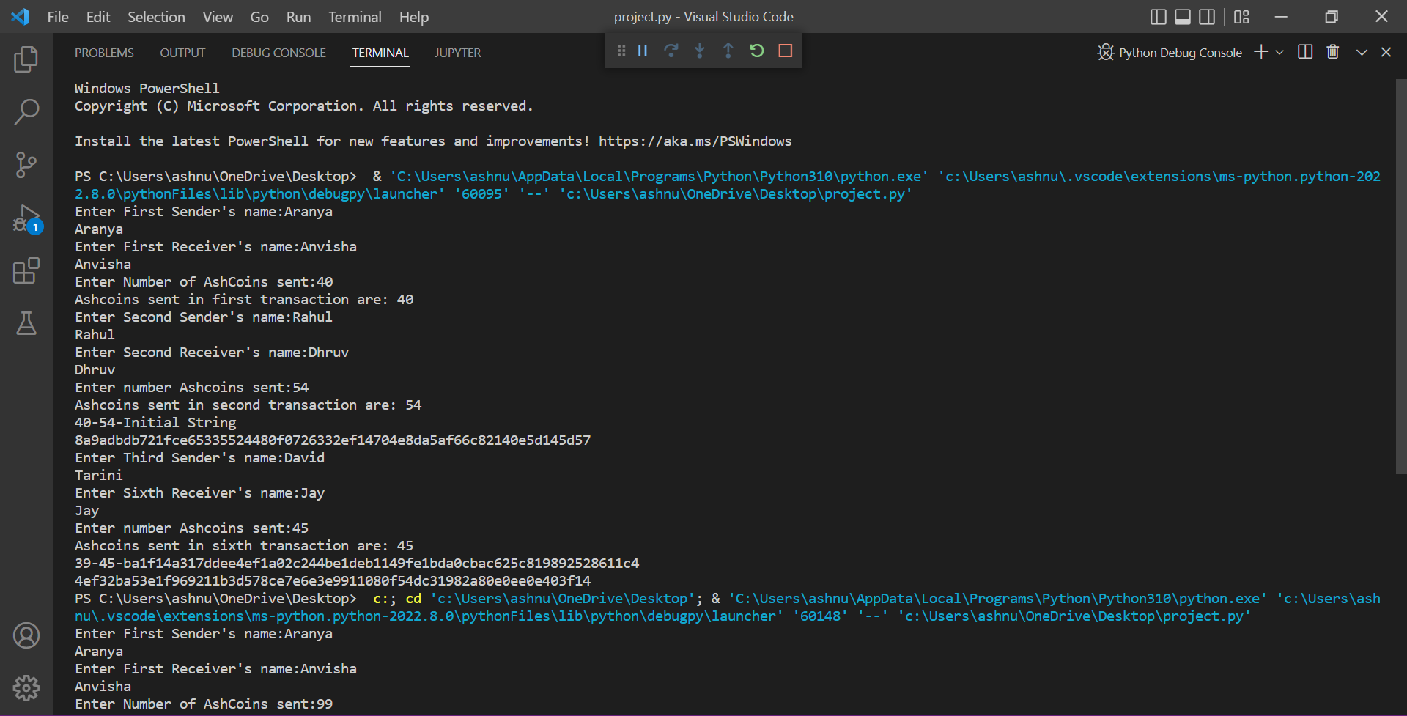

Slide 12
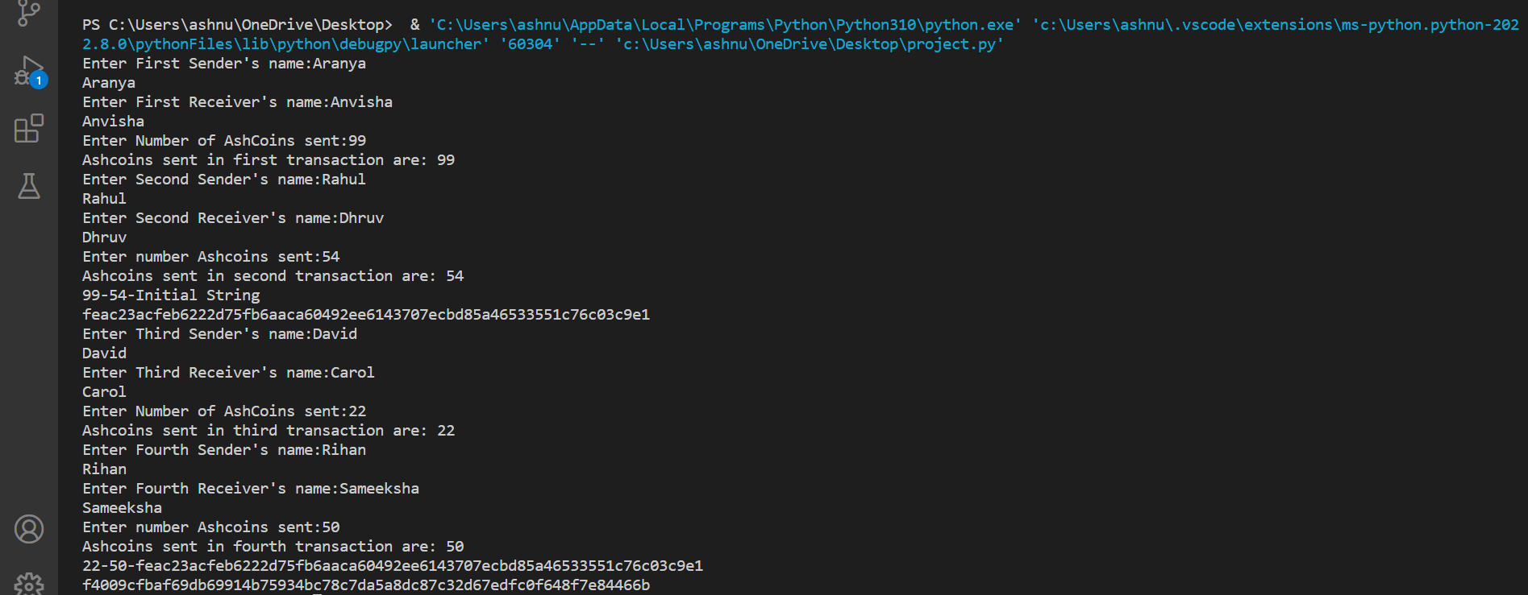

Slide 13
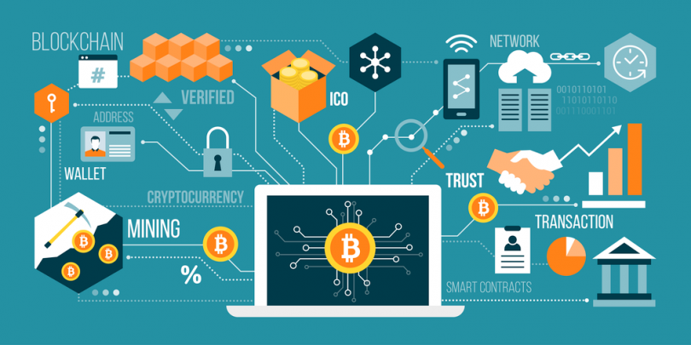
The output commences with taking in the record inputs from the user. Each block contains records of 2 transactions and the hash for each block is generated and interlinked.
Further to show the actual working of this blockchain transaction, in the last output image it is clearly visible that as soon as the minute change in first transaction is made the hash of the block is changed which in turn changes the hash of the next block as well and so on.
Thus, the visible difference even after a small change in the input makes this minor project a representative example of Blockchain.
Detailed discussion and further topics on the project and Blockchain technology have been included in the report.

Slide 14


